Slide 1
Big Mountain Resort Ticket Pricing
Rishab Ghose

Slide 2
Problem Identification
Big Mountain Resort is currently charging $81.00 per ticket, which is a premium above the average ticket price of resorts in its market segment
With new amenities being added, we are looking to provide a recommendation for a new optimal ticket price for the next ski season

Slide 3
Our Recommendations
Our model indicated that the ticket price should be increased to around $95.87
We also want to note:
closing one run would have no effect on this modeled ticket price.
Increasing vertical drop by 150 ft and adding a new chair would increase our modeled price by $1.99 (expected to increase revenue by around $3.5 million)
This may be worth it, depending on the costs of such rennovations

Slide 4
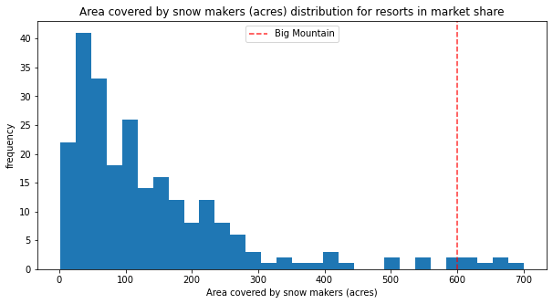
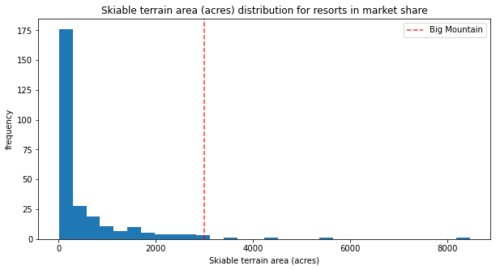
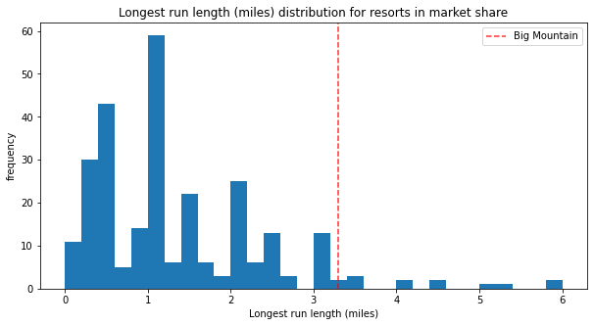
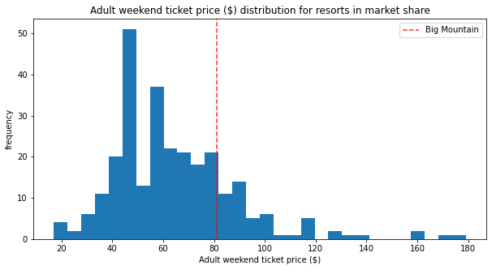
Analysis
Of the amenities that had the greatest influence on ticket price, Big Mountain resort lies at the top
Has a lower ticket price than several of the most expensive resorts

Slide 5
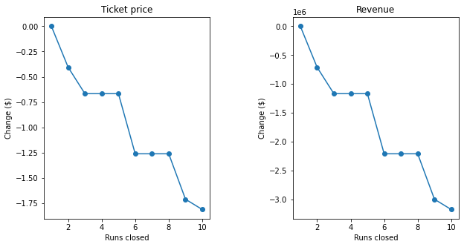
Modeling
Using a random forest algorithm, we found that an optimal price would be $95.87, with an error of $10.39 (this suggests that price could be even higher)
Seen on the graph to the right, closing one run causes no change to our modeled price or revenue

Slide 6
Conclusion
To do further analysis and give more specific recommendations, we would need more specific data regarding:
number of visitors per year from Big Mountain (and other resorts)
operating costs for specific amenities
elasticity of cost as visitors/tickets sold increases
Algorithm is not particularly large
Can be saved in your in-house data warehouse, taking up minimal storage space
Easy to use for in-house analysts

